Slide 1
Caritas Alba Iulia
Romania

Slide 2
Health begins in the family: Prevention and health promotion for families in precarious circumstances in Europe
“Councelling with parents on the topic of health”
5-7 December 2022
Trieste, Italy

Slide 3
Promoting health in disadvantaged communities

Slide 4
Promoting health in disadvantaged communities
Prospera Sepsi is a complex project financed by EU which aims to reduce the number of families living in poverty in Sf. Gheorghe
- it focuses on offering qualifications and councelling for employment
- it also has social and health component
- 5 partners

Slide 5
Promoting health in disadvantaged communities
Health component includes 2 screening activities in 3 diasdvantaged areas in Sf. Gheorghe for 600 people
Till now 283 people participated in screening
Screenings involved oftalmological, clear vision tests for children and adults, laboratory tests, arterial tension, blood tests, general internal evaluation implemented by Charity Service of the Order of Malta
further facilitation to medical servicies is offered by sanitary mediators according to needs

Slide 6
Promoting health in disadvantaged communities

Slide 7
Promoting health in disadvantaged communities

Slide 8
Promoting health in disadvantaged communities
BUDVÁR – ODORHEIU SECUIESC
Urban segregated Roma community with 1000 inhabitants
Low education/high unemployment
Seasonal work
unhealthy environment

Slide 9
Promoting health in disadvantaged communities
Health issues
lack of family doctor
Lack of health insurance
Lack of obligatory vaccines
Limited access to clean water
Scrabies, skin diseases, hepatitis, lice, measles

Slide 10
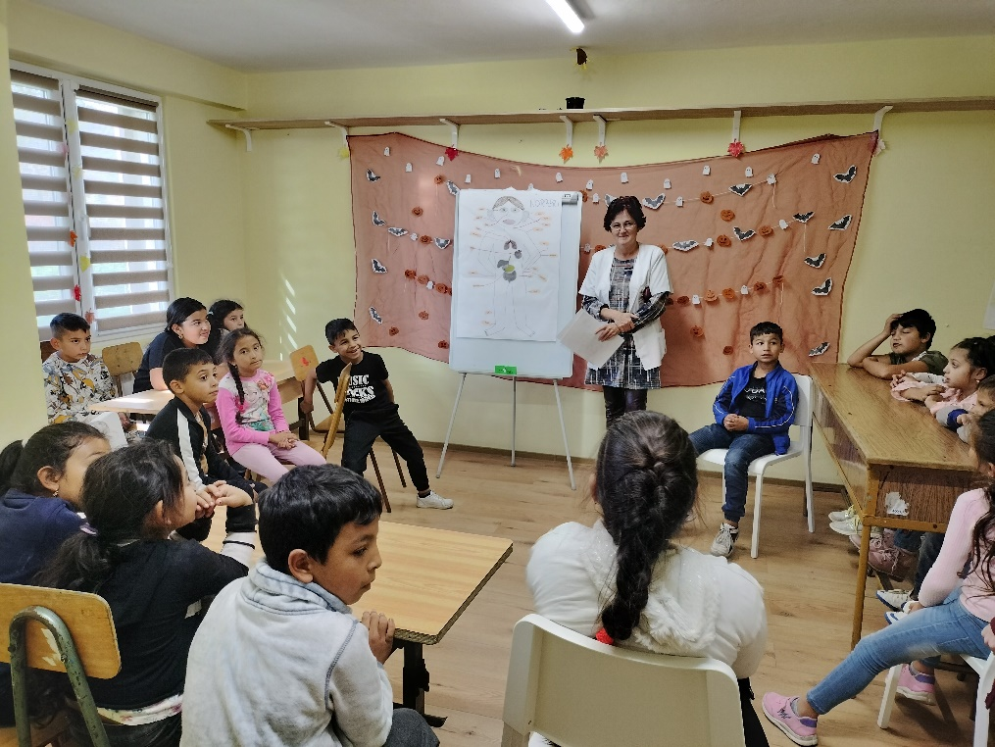
Promoting health in disadvantaged communities
BUDVÁR – DAY CENTER FOR ROMA CHILDREN
Increase motivation for school
Prevent school drop-out
Support children for finishing elementary school and continue their education.
Develop social and individual skills for an independent life
Promoting healthy lifestyle
-

Slide 11
Promoting health in disadvantaged communities
BUDVÁR
The Together for all – Integrated social interventions for inclusion of the marginalized regions of Odorheiu Secuiesc project is funded by Iceland, Liechtenstein and Norway through the EEA Grants Fund

Slide 12
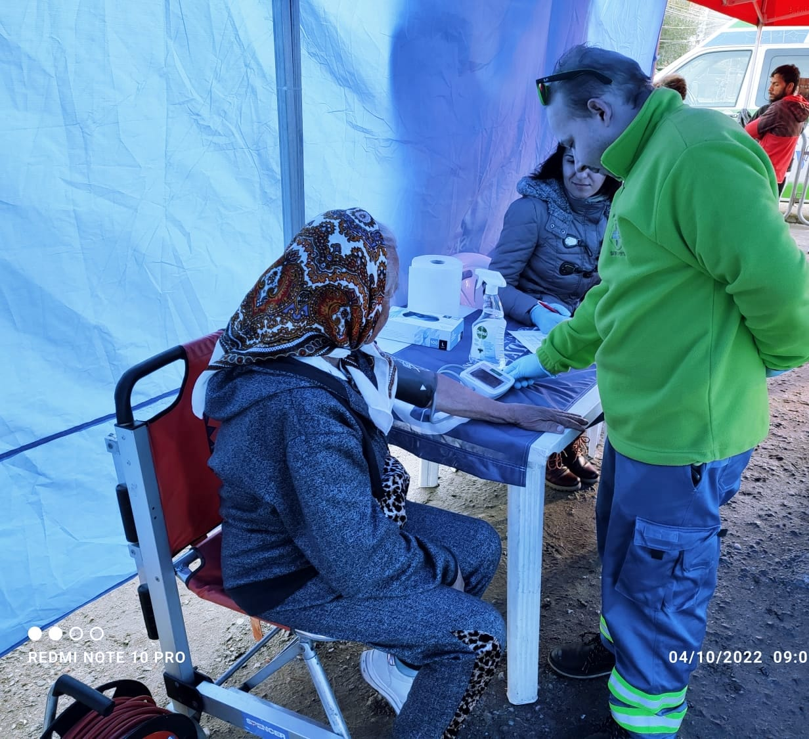
Promoting health in disadvantaged communities
Health component
facilitating acces to health services
medical screening
accompanying families to doctors
preventing diseases
camps and activites for children with emphasys on promoting health

Slide 13
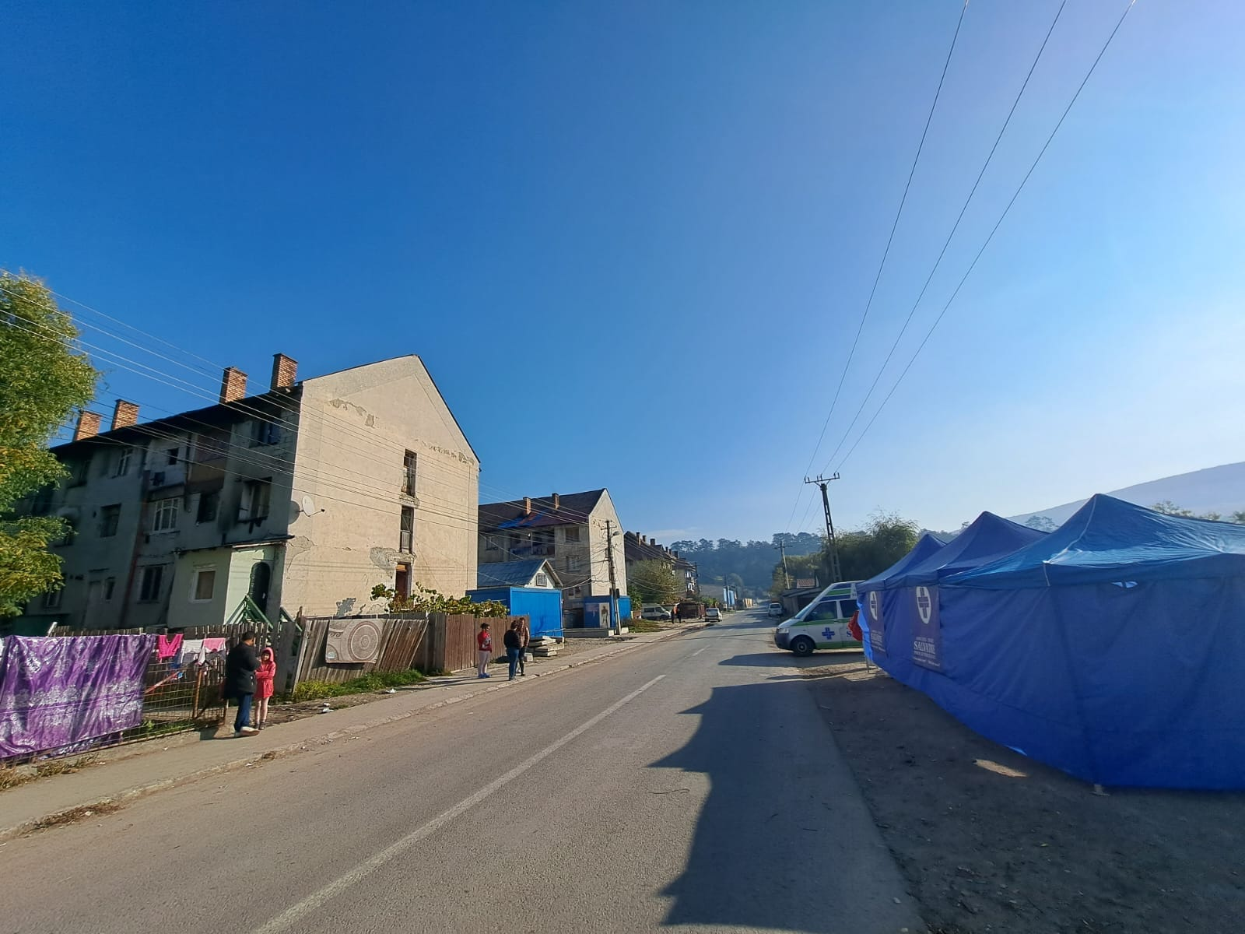
Promoting health in disadvantaged communities

Slide 14
Thank you for your attention!

